Slide 1
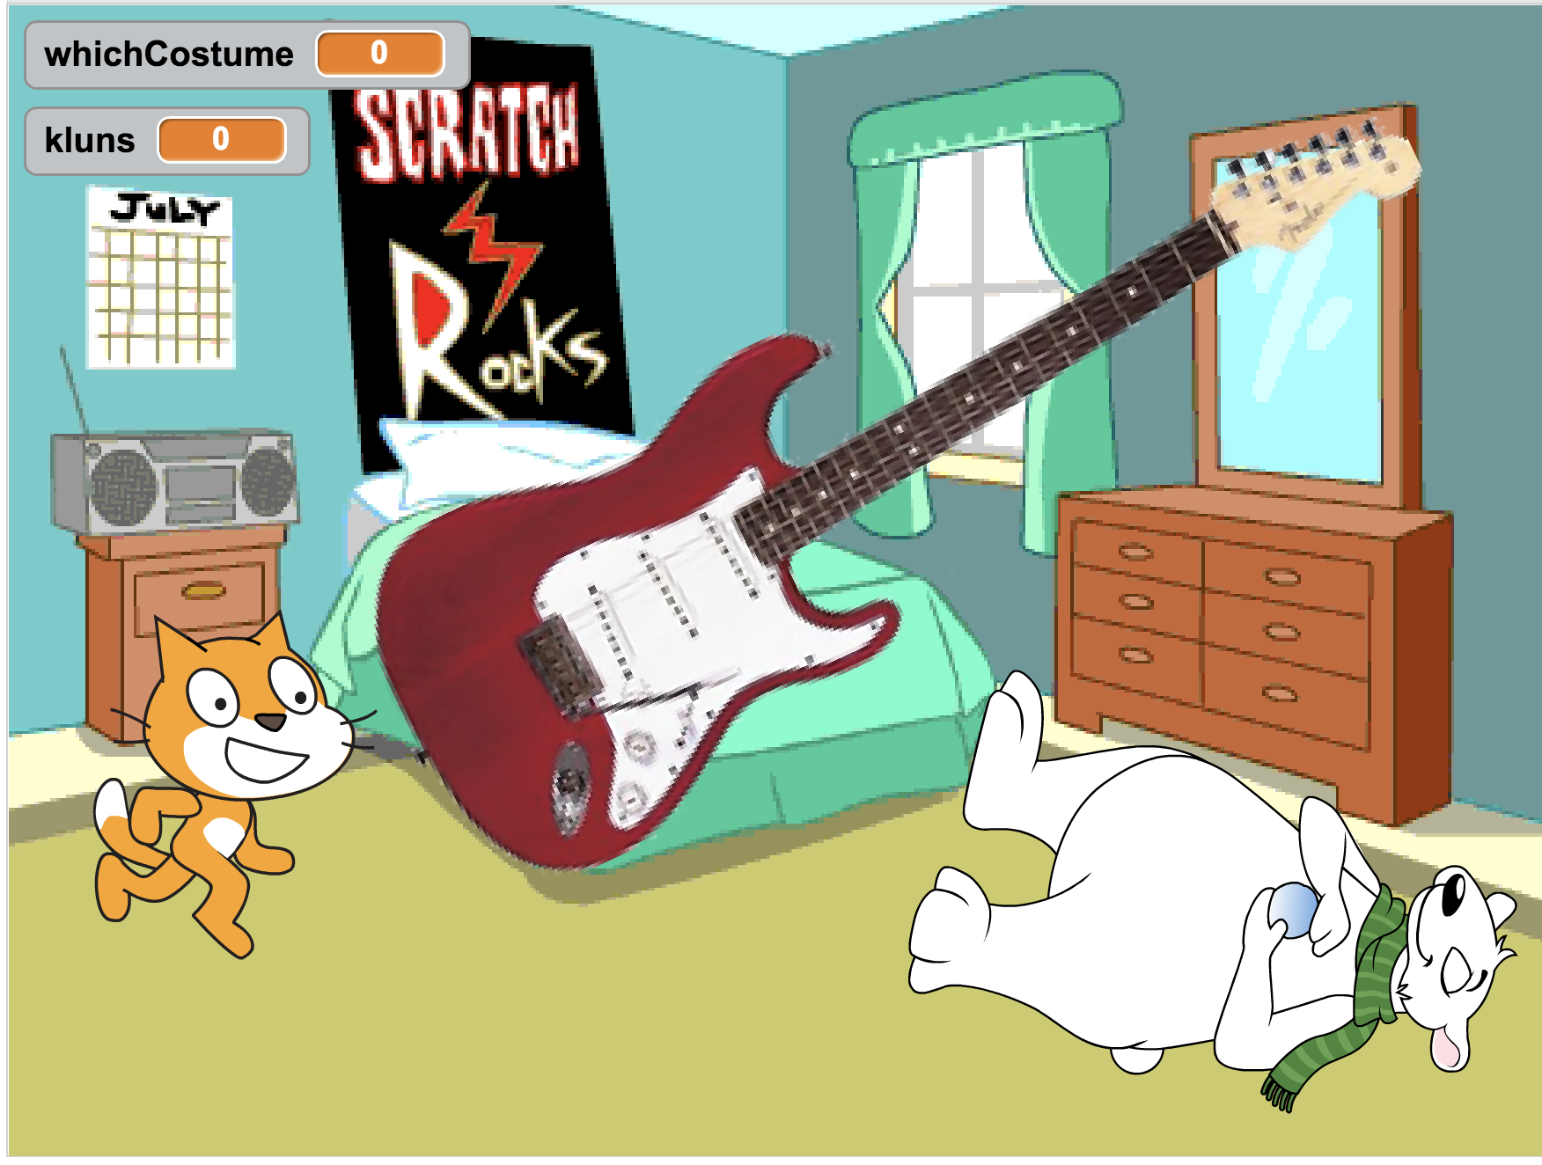
Game day!
Scratch and MaKeyMaKey

Slide 2
Today
You will learn some interaction
You will have to be creative
You will be doing teambuilding in your Project 1 teams
You will get to know students from another class
We want you to have some fun!!

Slide 3
Today’s Purpose: Create a game!
Create a game that combines physical objects/ the analogue and the digital using Scratch and a MaKeyMaKey
Create one or more posters to attract players to your game
You have quite a lot of time so be careful to create a fun and engaging experience for your audience
There will be prizes for best games!

Slide 4
What is a game?
Roger Caillois (1913-1978) defined the nature of games:
1. A game is free, or not obligatory
2. it is separate from the routine of life, occupying its own time and space
3. it is uncertain, so that the results of play cannot be pre-determined and the player's initiative is involved
4. it is unproductive in that it creates no wealth, and ends as it begins economically speaking
5. it is governed by rules that suspend ordinary laws and behaviours and that must be followed by players
6. it involves imagined realities
By: Caillois, Rover "Les Jeux et Les Hommes" (1967)

Slide 5
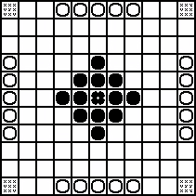
What kinds of games do we have?
Caillois, Rover "Les Jeux et Les Hommes" (1967)
Notes:
Agon: er kappestriden, hvor den bedste mand vinder og man deltager for at vinde Udgangspunktet er fairness, lige vilkår for deltagerne. Der er skrevne eller uskrevne regler, som regulerer adfærden.
Alea: er chancespillet, hvor udfaldet er rent lotteri (terningspil, roulette). Efter at spilleren har gjort sit valg eller sin indsats, er han kun afventende, har jeg gættet rigtigt?
Mimicri: er rollespillet, teater, far-mor-og-børn, den hemmelige klub, hvor spilleren lever sig ind i en anden person og en anden virkelighed.
Ilinx: er ekstasejagten, bjergbestigning, ekstremløb, elastikspring, hvor spilleren er i kamp med sig selv, kan jeg, tør jeg, og hele tiden konfronteres med konsekvenserne af sine valg.

Slide 6
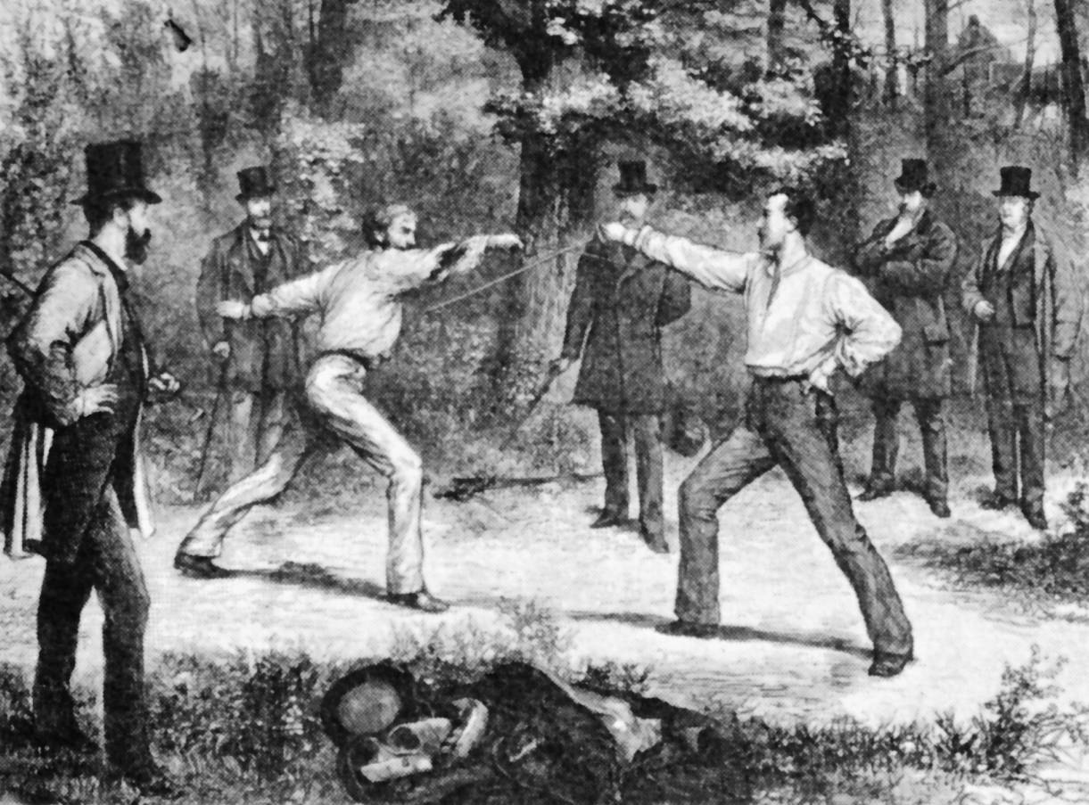
Agon
Competition
“May the best man win”
(Even if you try to tell each other that participation is more important.)
The starting point is fairness, equal terms for the participants.

Slide 7

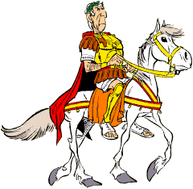
Alea
The chance game where the outcome is pure lottery (dice game, roulette).
After the player has made his choice or effort, he can only wait, have I guessed correctly?

Slide 8
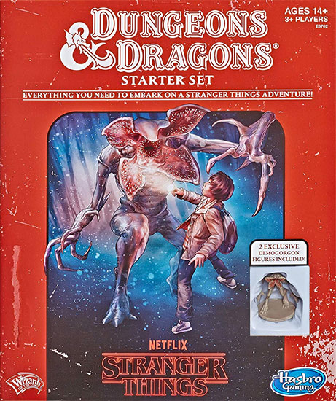
Mimicry
Is the role-play, theater, playing house, the secret club where the player lives in another person and another reality.

Slide 9

Ilinx
Chasing ecstacy:
mountaineering,
extreme running,
bungee jumping
Etc.
The player is struggling with herself.
Being constantly confronted with the consequences of her choice.

Slide 10
Your game plan for today
Do a brainstorm, spend some time coming up with a great game idea
Build it using Scratch and MaKeyMaKey
Promote your game (you should at least have a colorful poster, or a booth that advertises and explains your game)
Deadline: Your game must be ready to play at 13:00

Slide 11
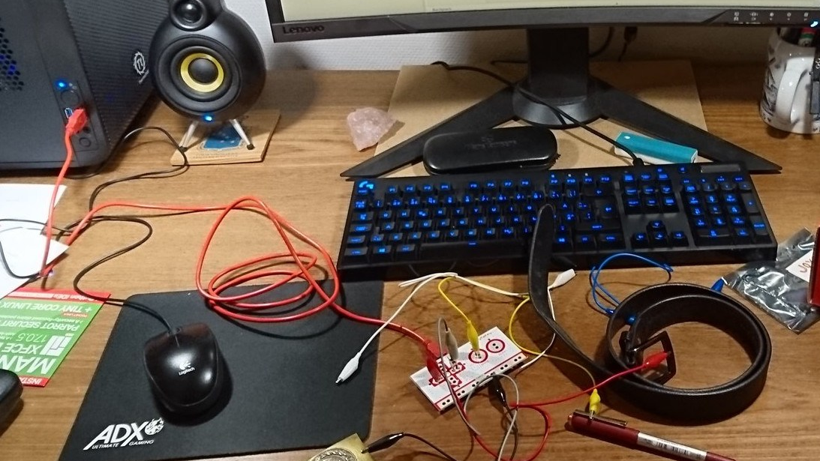
MaKeyMaKey
How to use the MaKeyMaKey
Short Demo

Slide 12
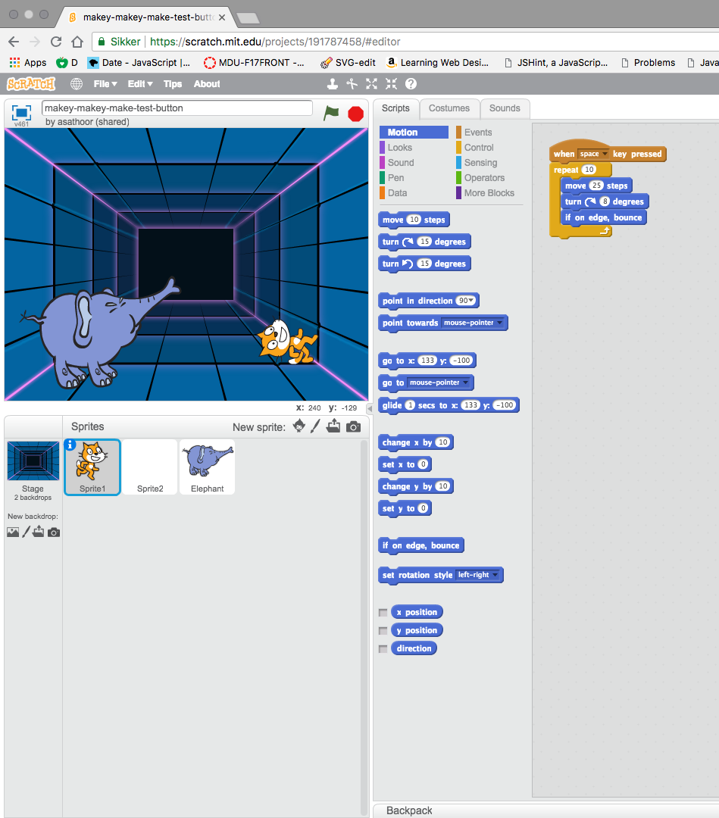
Scratch
Short demonstration

Slide 13
Links
Scratch: https://scratch.mit.edu/
MaKeyMaKey: https://labz.makeymakey.com/
Scratch Tips: https://scratch.mit.edu/tips
Scratch Getting Started Tutorial: https://bit.ly/2vLA4Pq
Activity Cards: https://bit.ly/2IjVTK7

